Slide 1

Agenda Items
Linked In List: Basics and Advanced Concepts
Linked In Examples and Use Cases
Notes:
--- We will begin with an introduction to data structures and algorithms, discussing their definitions and significance. Following that, we will dive into arrays, covering their basics, advanced concepts, examples, and use cases. Next, we will explore linked lists, their structure, operations, and applications. Finally, we'll compare arrays and linked lists to help you choose the right data structure for your needs. Image source: Microsoft 365 content library

Slide 2
Linked Lists: Basics and Advanced Concepts
Notes:
Linked lists are a dynamic data structure that consists of a sequence of nodes, each pointing to the next. This structure allows for efficient memory usage and flexibility in size.

Slide 3

Definition and Structure of Linked Lists
Linked List Concept
A linked list is a linear data structure where each element contains a reference to the next element, forming a chain.
Dynamic Memory Allocation
Linked lists allow for dynamic memory allocation, enabling efficient use of memory as elements can be added or removed easily.
Insertion and Deletion
Linked lists facilitate easy insertion and deletion of elements without the need for shifting other elements, enhancing performance.
Notes:
--- A linked list is a linear collection of data elements, where each element points to the next. This allows for dynamic memory allocation and easy insertion and deletion of elements. Image source: Microsoft 365 content library

Slide 4
Types of Linked Lists (Singly, Doubly, Circular)
Singly Linked Lists
Singly linked lists consist of nodes that contain data and a pointer to the next node, allowing for a one-way traversal.
Doubly Linked Lists
Doubly linked lists have nodes that contain data, a pointer to the next node, and a pointer to the previous node, enabling two-way traversal.
Circular Linked Lists
Circular linked lists connect the last node back to the first node, allowing continuous traversal without a null pointer.
Notes:
Linked lists can be categorized into singly linked lists (one-way pointers), doubly linked lists (two-way pointers), and circular linked lists (last node points to the first), each offering different functionalities.

Slide 5
Operations on Linked Lists (Insertion, Deletion, Traversal)
Insertion Operation
Insertion in a linked list can occur at the beginning, end, or at a specific position, offering flexibility in data management.
Deletion Operation
Deletion involves removing a node from the linked list, which can be challenging as it requires updating pointers appropriately.
Traversal Operation
Traversal in linked lists allows access to each node sequentially, which differs from array access methods.
Notes:
Linked lists support various operations such as insertion, deletion, and traversal. Each operation has different complexities and may require different approaches compared to arrays.

Slide 6
Linked List Examples and Use Cases
Notes:
Linked lists are useful in scenarios that require frequent resizing or complex data manipulations. In this section, we will explore practical examples and applications.

Slide 7

Example: Implementing a Music Playlist
Linked List Structure
A linked list is a data structure where each element, or node, contains a value and a reference to the next node.
Adding Songs
Users can easily add songs to their playlist by creating new nodes and linking them in the list.
Removing Songs
Songs can be removed from the playlist by unlinking nodes, which is efficient due to the linked list structure.
Notes:
--- Linked lists can be used to implement a music playlist, where each song is a node. This allows users to easily add, remove, and navigate through their playlist. Image source: Microsoft brand library

Slide 8

Industry Use Case: Linked Lists in Memory Management
Dynamic Memory Management
Linked lists facilitate dynamic memory management by efficiently tracking free memory blocks in a system.
Efficient Memory Allocation
Using linked lists, systems can allocate memory efficiently, minimizing fragmentation and optimizing resource use.
Notes:
--- Linked lists are often used in dynamic memory management, allowing systems to keep track of free memory blocks and allocate memory efficiently. Image source: Microsoft brand library

Slide 9

Advantages and Limitations of Linked Lists
Dynamic Sizing
Linked lists allow for dynamic sizing, meaning they can grow and shrink in size as needed without memory wastage.
Efficient Insertion/Deletion
Insertion and deletion operations in linked lists are efficient, as they do not require elements to be shifted as in arrays.
Slower Access Times
Linked lists have slower access times compared to arrays due to non-contiguous memory storage, making direct access less efficient.
Notes:
--- Linked lists provide advantages like dynamic sizing and efficient insertion/deletion but have limitations such as slower access times compared to arrays due to non-contiguous memory storage. Image source: Microsoft 365 content library

Slide 10
Example walkthrough
Problem Statement:
Given an unsorted linked list containing n nodes, the task is to remove duplicate nodes while preserving the original order.
Examples:
Input: 12 -> 11 -> 12 -> 21 -> 41 -> 43 -> 21
Output: 12 -> 11 -> 21 -> 41 -> 43
Explanation: The second occurrence of 12 (the one after 11) and the second occurrence of 21 (the one at the end) are removed, resulting in a linked list that maintains the order of their first appearances.
Input: 1 -> 2 -> 3 -> 2 -> 4
Output: 1 -> 2 -> 3 -> 4
Explanation: Similarly, the second occurrence of 2 is removed, ensuring that each number appears only once while maintaining the order of their first appearances.

Slide 11
Do it yourself – Practice problems
Problem | Complexity
https://leetcode.com/problems/merge-k-sorted-lists | Hard
https://leetcode.com/problems/remove-nth-node-from-end-of-list | Medium
https://leetcode.com/problems/copy-list-with-random-pointer | Medium
https://leetcode.com/problems/flatten-binary-tree-to-linked-list | Medium
https://leetcode.com/problems/reverse-nodes-in-k-group | Hard
https://leetcode.com/problems/linked-list-cycle-ii | Medium
https://leetcode.com/problems/sort-list | Medium
https://leetcode.com/problems/swap-nodes-in-pairs | Medium
https://leetcode.com/problems/reverse-linked-list-ii | Medium
https://leetcode.com/problems/lfu-cache | Hard
https://leetcode.com/problems/design-twitter | Medium
https://leetcode.com/problems/lru-cache | Medium

Slide 12
Comparing Arrays and Linked Lists
Notes:
Understanding the differences between arrays and linked lists is essential for choosing the right data structure based on specific performance needs and application requirements.

Slide 13
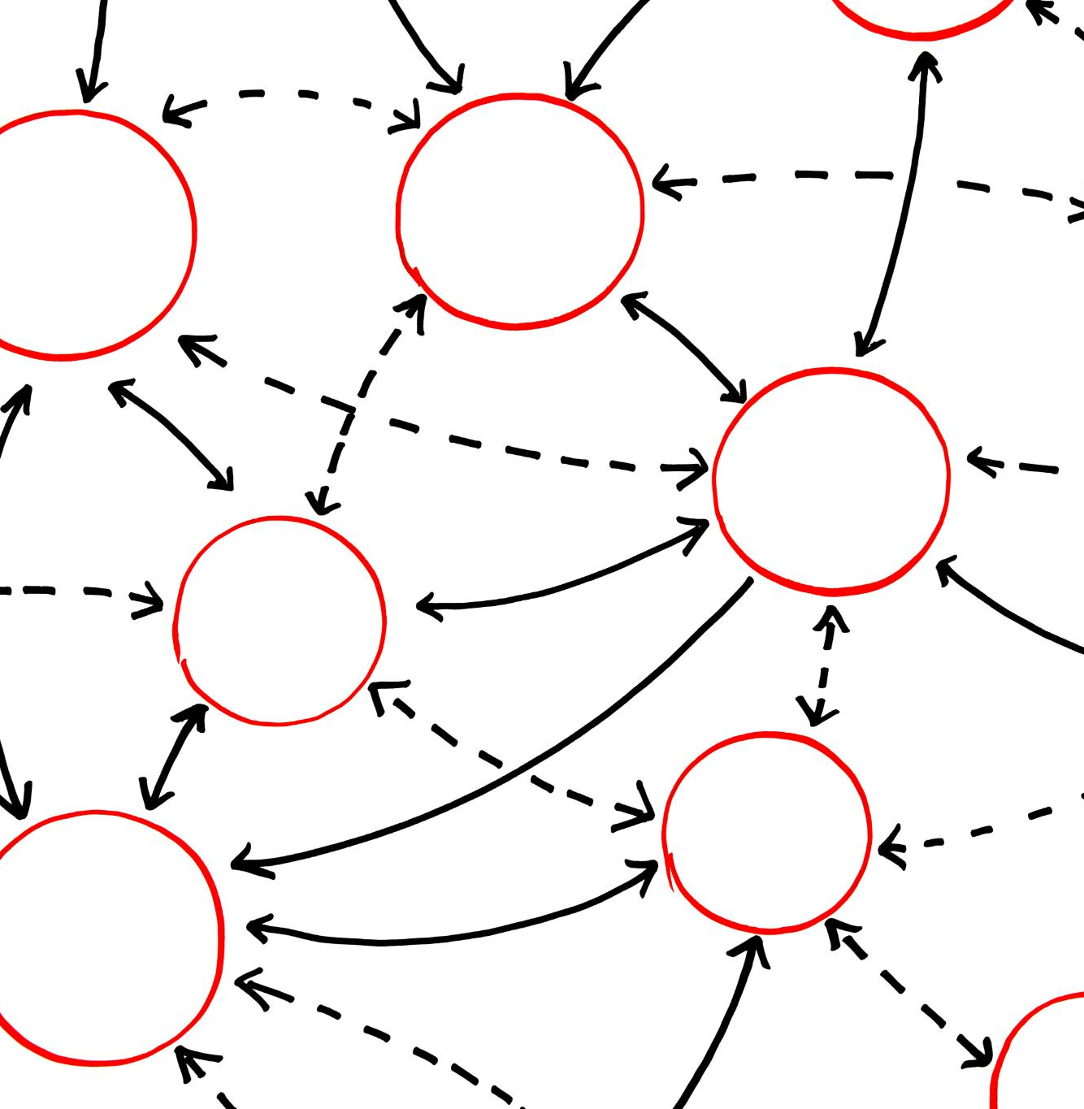
Performance Comparison (Time Complexity)
Array Access Time
Arrays provide O(1) access time, allowing for immediate retrieval of elements by index.
Linked List Access Time
Linked lists have O(n) access time for random elements, requiring traversal for access.
Notes:
--- When comparing arrays and linked lists, it's important to consider time complexity for operations. Arrays offer O(1) access time, while linked lists have O(n) access time for random elements. Image source: Microsoft 365 content library

Slide 14
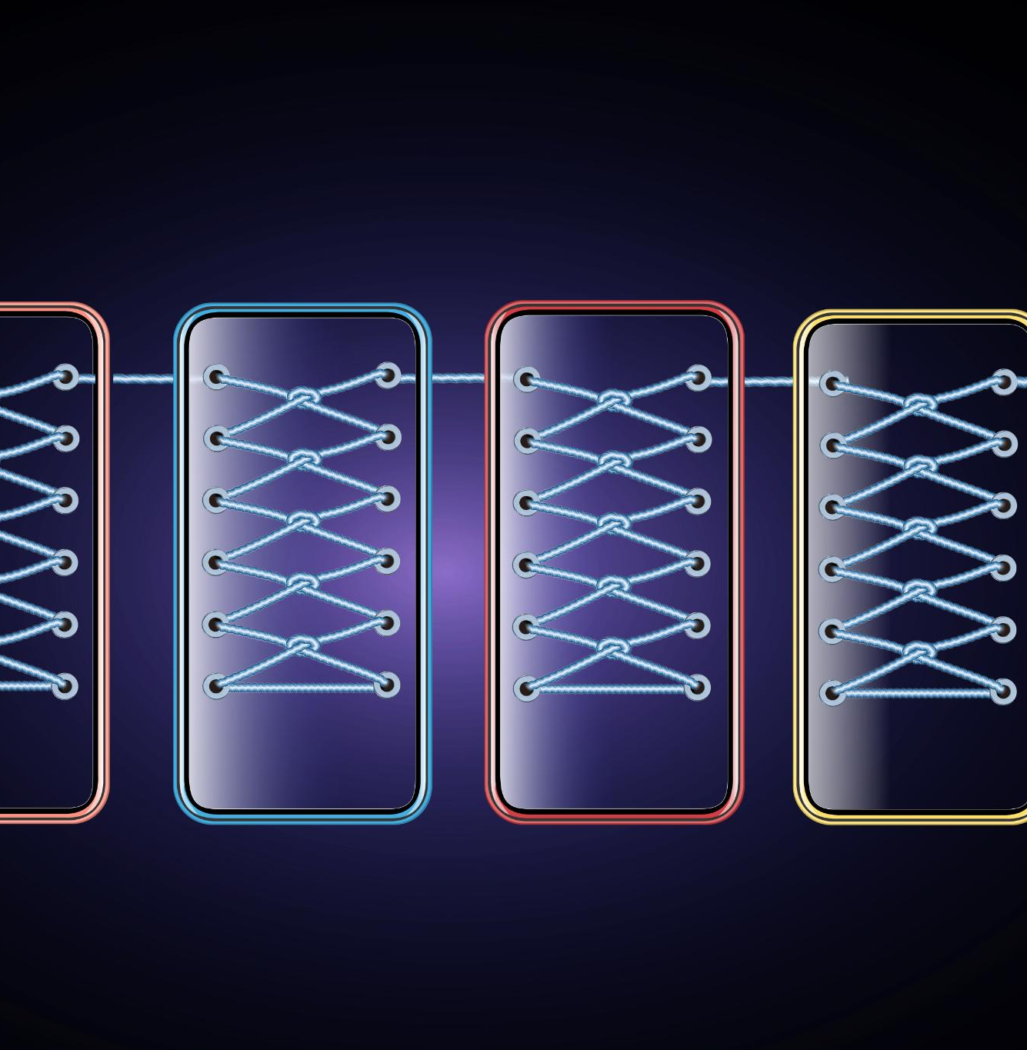
Memory Usage and Allocation
Fixed Memory Allocation
Arrays allocate a fixed amount of memory, which can result in unused space leading to inefficient memory usage.
Dynamic Memory Allocation
Linked lists utilize dynamic memory allocation, allowing memory to be allocated as needed and improving efficiency.
Notes:
--- Arrays have fixed memory allocation, which can lead to waste if not fully utilized. Linked lists use dynamic memory allocation, allowing for more efficient use of memory space. Image source: Microsoft 365 content library

Slide 15
When Should You Use a Linked List?
You should use a linked list over an array when:
You don't know how many items will be in the list (that is one of the advantages - ease of adding items).
You don't need random access to any elements (unlike an array, you cannot access an element at a particular index in a linked list).
You want to be able to insert items in the middle of the list.
You need constant time insertion/deletion from the list (unlike an array, you don't have to shift every other item in the list first).

Slide 16

Choosing the Right Data Structure for the Problem
Arrays vs. Linked Lists
Arrays are suitable for fixed-size collections, allowing for fast access to elements by index.
Insertion and Deletion
Linked lists are better for applications requiring frequent insertions and deletions, providing dynamic size adjustments.
Notes:
--- When deciding between arrays and linked lists, consider the specific requirements of your application. Arrays are best for fixed-size collections, while linked lists excel in scenarios with frequent insertions and deletions. Image source: Microsoft 365 content library

Slide 17
Conclusion
Importance of Data Structures
Understanding data structures like arrays and linked lists is crucial for efficient programming and problem-solving.
Strengths and Weaknesses
Each data structure has unique strengths and weaknesses that influence their use in different scenarios.
Choosing the Right Structure
Selecting the appropriate data structure is essential for optimizing code performance and resource usage.
Notes:
Understanding arrays and linked lists is fundamental to mastering data structures and algorithms. Each data structure has its strengths and weaknesses, making it important to choose the right one based on the problem at hand.

